Slide 2
+
-

Slide 3
HOW TO SET EFFECTIVE GOALS
The place for outrageous goals is the 5+ year section.
In the 3 year is where you put 'I'm not sure how to get there, but I'm certain it's possible.'
And in the 12 months section you do need to keep current reality in mind as current reality does play a part, but definitely stretch that reality as far as you think you can trick your mind to believing in it.

Slide 4
Vision Mastery Part 1
Write down what you want in the 5 year box first
Then put in the 3 year what you think needs to happen on the journey to help you get there
Then write one or two things in the 1 year that will help you get to that 3 year mark.
We are going to fill more in but I just want everyone to start with one or two things in each. Make them your main things.

Slide 5
HOW TO SET EFFECTIVE GOALS
The key word here is... TANGIBLE. PRECISION IS CRUCIAL. It's essential that your goal setting process is clear cut.

Slide 6
HOW TO SET EFFECTIVE GOALS
“Make Art more often" vs “Complete 10 new pieces of Art”

Slide 7
HOW TO SET EFFECTIVE GOALS
“Create a business out of my artwork
Vs
Create a business selling my artwork that generates me $100K in a single year.”

Slide 8
HOW TO SET EFFECTIVE GOALS
“Sell my art on Instagram “
Vs
“Sell 10 pieces of art to people that I have never met but found my work by following me on Instagram.”

Slide 9
+
-

Slide 10
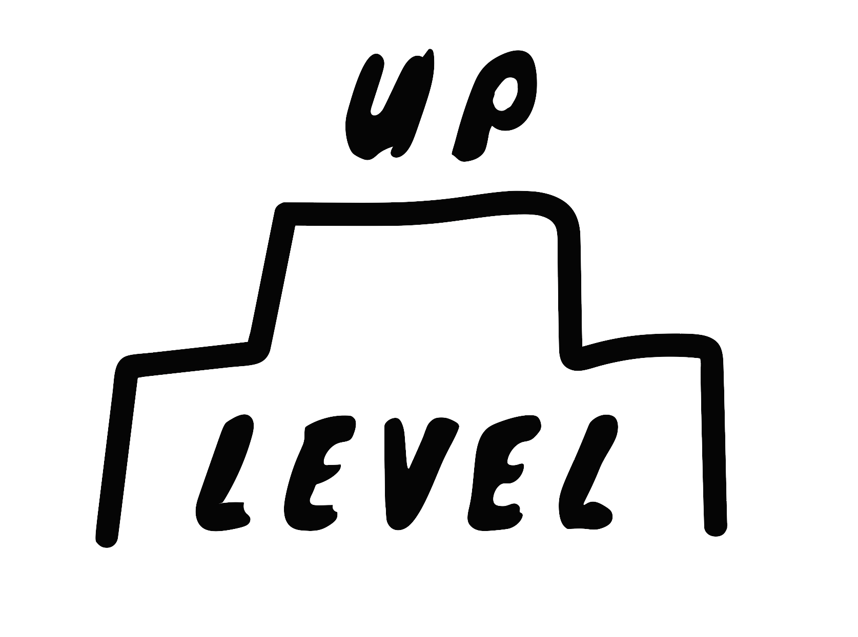
WHY??

Slide 11
Motivation & how will it feel to achieve your goals
You have heard it before… Probably many times… It's the WHY that gets you going, not the HOW.

Slide 12
+
-

Slide 13
Boulder
Lag target
Rocks
Lead Targets
Pebbles
Sand

Slide 14
Boulder
Lag target
Rocks
Lead Targets
Pebbles
Sand

Slide 15
Boulder
Lag target
Rocks
Lead Targets
Pebbles
Sand

Slide 23
Books and self-development resources in line with this
When people tell you to read this book and that book, it may sound good, but you know you are ‘not a book person’... or you tell yourself you'll never have the time and that's the end of the conversation. You may even write down the name of the book with good intentions, but knowing that the chances of actually reading it are slim.
Thats where your new valuable NET tool comes into play for knowledge consumption. NET = No Extra Time. This means if you can get the knowledge into you while you are doing something else that requires minimal brain activity then you are winning, as you have not needed to sacrifice extra time to do so. Cleaning? Working out? Sitting on public transport? This is when you utilise your NET to make time for your audiobooks.
Time is your most valuable commodity. So download the audible app on your phone if you haven't already. Set up your account on your computer browser (it’s easier to set up on a pc) and then download your first Audio book on your app. Once you have a membership, the hack is to use your monthly credits on the expensive books as you’re paying the same amount for these credits each month. Then, you can purchase the cheaper books outright. Books (aka knowledge) are the best ROI you can get in the world. Where else can you turn $15 into information that could make you a millionaire over time?
If you are new to self development I would recommend picking one or both of the top two most sold self development books of all time.
1. Think and Grow Rich - Over 80 million copies sold
Perched at the pinnacle of the self-help bestsellers roster is Napoleon Hill's seminal work. Hill gleaned insights from the era's business titans, distilling foundational principles and behaviors that underpin achievement. Key among these are the cultivation of desire, the nurturing of faith, steadfast persistence, and the deliberate quelling of skepticism and negative thoughts. Its enduring legacy cements the status of this book as a classic.
2. The Alchemist - Over 65 million copies sold
Paulo Coelho rivets readers with the narrative of a young shepherd on a quest for treasure. This young man's odyssey imparts the critical lesson of heeding one's heart and ambitions, all while valuing the journey itself. Even as a work of fiction, its subtle yet powerful message places it among the top-selling self-help books ever written.

Slide 24
Books and self-development resources continued…
Think about what kind of information you are consuming on a daily basis. Have you noticed how social media or television impacts your thinking?
Just like if you were to consume junk food for breakfast, lunch and dinner, your body is going to give you negative feedback. It’s not going to want to assist you to smash your day or week out of the park because of the unhealthy fuel you have provided it. If you feed it healthy food, it will be far more likely to provide you with the physical momentum you seek to get you through your lifetime.
The same goes with your mind; if you are constantly putting good books into your head, you'll be getting constant positive mental feedback which will help you drive your life in the direction of where you want to be and - You will get there a lot faster!
Podcasts are also great, but be careful as you may get tricked into thinking you are consuming the right stuff, though a lot of the time it’s just space-filler or entertainment. These streams don't deliver the magnitude of condensed knowledge you can get from reading well thought-out books from experts in different fields.

Slide 25
Crafting your personal reading list for success
With your goals now clearly outlined, it's time to complement your roadmap with a tailored collection of knowledge. In this chapter, I encourage you to craft your own reading list that aligns with each goal you've set. Books - especially audio books that can be listened to in various settings - can be powerful allies in your journey towards realising your artistic vision. They offer not just information, but companionship and insight on the long road to achieving your dreams. Here’s how you can approach this:
Align Your Reading with Your Goals:
For each goal you've written down, think about what knowledge or inspiration could propel you forward. Is there a particular skill you want to master, or a mindset you wish to adopt?
Identify Key Themes:
Look for books that resonate with the themes of your goals. For example, if your goal is to become more innovative in your art, you could seek out books that explore creativity and original thinking.
Diversify Your Selection:
Choose a mix of practical guides, inspirational stories, and theoretical works to give you a well-rounded perspective and a comprehensive outlook. I swear by the audiobook recipe of the following: three educational books for every one motivational. This is because motivational books can act like a hit that people chase just for the buzz, which can diminish over time. These books tend to be a very important factor in your journey, but no need to over do it people.
(However, now that I’ve brought it up, if you do want a good hit… Probably the ultimate kick-up-the-ass book in the self development sector would be Grant Cardone and his book The 10x Mentor. Give that a read and then reach out to me - I love a good Uncle G chat!)

Slide 26
Crafting your personal reading list for success continued…
As you list your books, remember this is a fluid document - this means the reading list is meant to evolve as you do. Start with what calls to you now and be open to discovering new resources as you progress. A lot of the time while reading one book, the author will recommend other books that resonate with you… and thus the learning journey just keeps on going!
Finally, should you need assistance or recommendations tailored to your specific artistic endeavors, don't hesitate to reach out.
Embark on this literary expedition with an open heart and an eager mind. Let the books you choose be the mentors you need for each chapter of your creative journey. Write notes, immerse yourself in the new wisdom you find, and watch as your goals, one by one, begin to materialise!

